Slide 1

AIM INFOYS AND OFAD SYSTEMS CAPSTONE PROJECT
TOPIC:
"Assessing the Impact of Natural Disaster-Related Diseases on Countries or Regions' CPI and Standard of Living: A Data-Driven Analysis “
(Data Analysis Project)
BY
NAME: Kingsley Chiege, Onah
NYSC REG NO: EK/24C/2471

Slide 2
INTRODUCTION
Background: "Natural disasters can have devastating effects on economies and populations, particularly in regions with inadequate healthcare infrastructure and disaster preparedness.“
Research question: What is the impact of natural disaster-related diseases on CPI and standard of living in Countries or Regions Affected?"

Slide 3
RESEARCH OBJECTIVES
• To assess the impact of natural disaster-related diseases on CPI and standard of living.
• To identify the most affected countries and regions.
• To inform policy decisions for disaster preparedness and response.
METHODOLOGY
• Data source: EM-DAT, a comprehensive global database on natural disasters.
• Analytic tools: Python programming language with libraries including pandas, matpoltlib, plotly.express, seaborn and numpy used for data analysis and visualization.
• Analytical approach: Descriptive and exploratory data analysis to uncover patterns and trends.

Slide 4
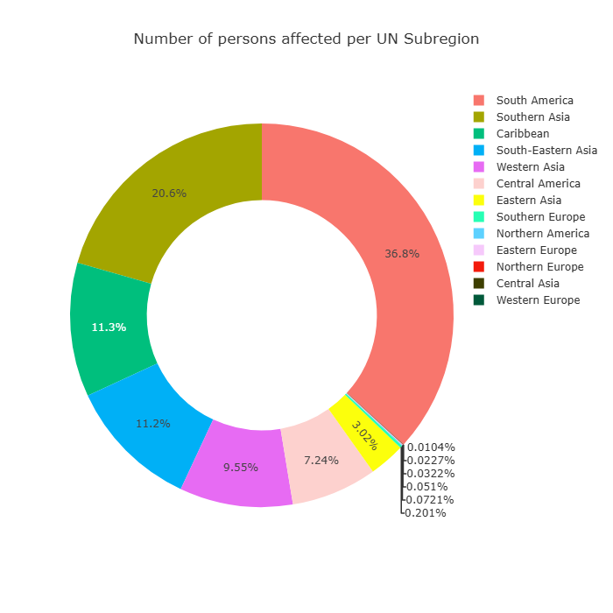
Donut plot by UN Sub region: The donut plots South America and South Asia are significantly affected with 36.8% and 20.6% Affected respectively, while Northwestern Europe is relatively less affected with and 0.0104%

Slide 5
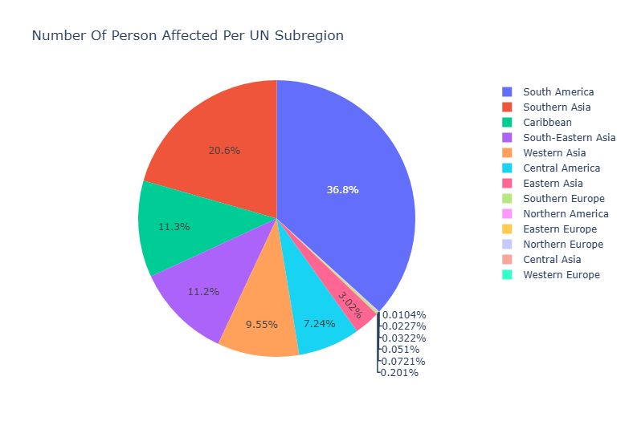
Pie Chart by UN Sub region:

Slide 6
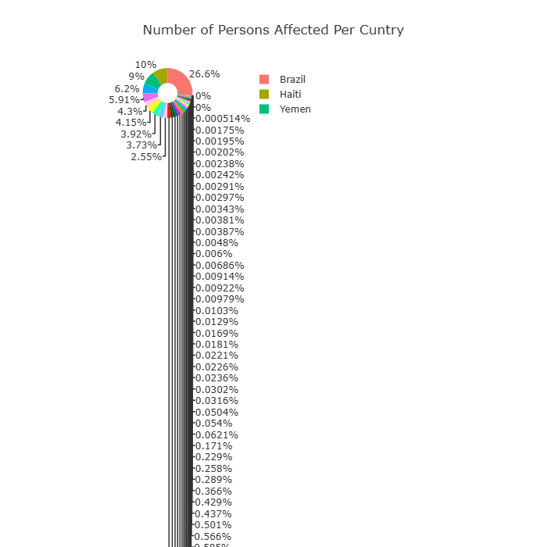
Donu chart by country: The donut plots show tha Brazil is the most affected country, accounting for 26.6% of the impact, followed by Haiti with 10%
While in least affected countries United Kingdom and Northern Ireland show negligible percentage with 0.001749 % and 0.000514% respectively.

Slide 7
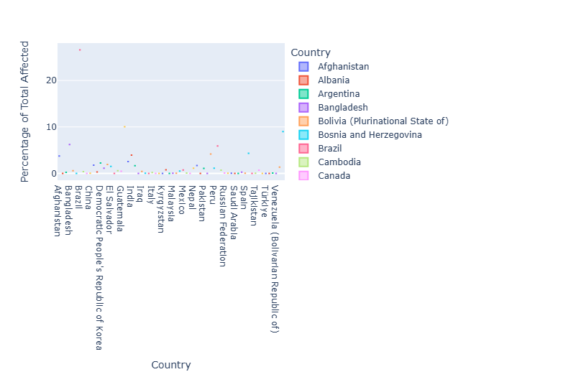
visualization
1. Box plot: "The box plot shows the distribution of disease impact across countries in South America, with Brazil appearing as an outlier.
. *

Slide 8
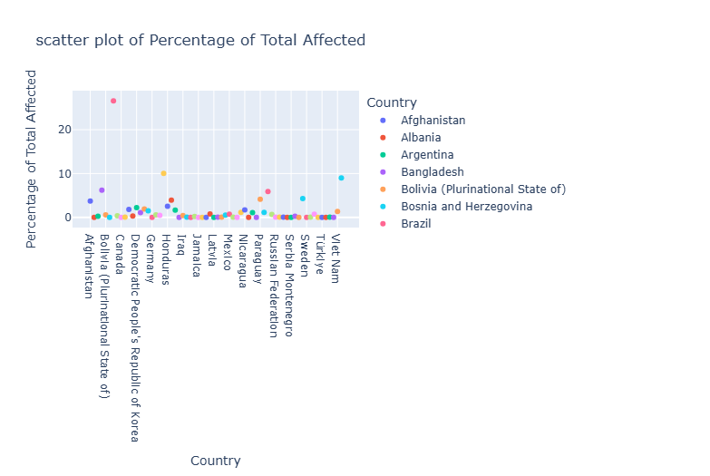
Scatter plot: The scatter plot further illustrates Brazil's outlier status, highlighting its unique position in terms of disease impact on the country.

Slide 9
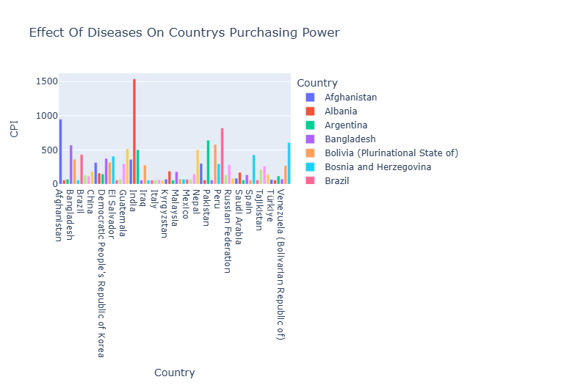
CPI Bar plot: The analysis shows that while Brazil was the most affected country by the epidemic, the CPI bar plot reveals that India had the highest CPI impact, suggesting that India’s large population and economic factors may have contributed to its significant economic instability.

Slide 10
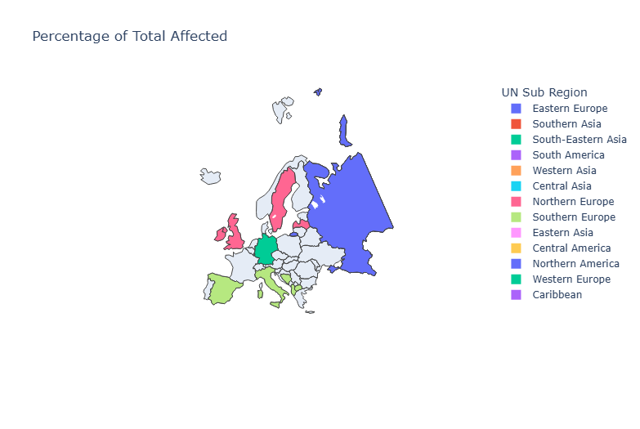
Map Plot by UN Sub region:

Slide 11
FINDINGS
: Disease Impact:
Key findings: Our analysis reveals that viral diseases have a significant impact, with Brazil being one of the most affected countries (26.6th percentile).
Country-specific insights: Haiti is also heavily affected by bacterial diseases (10th percentile), while United Kingdom and Northern Ireland are among the least affected countries.
Regional patterns: South America and South Asia are significantly affected with 36.8% and 20.6% Affected respectively, while Northwestern Europe is relatively less affected with and 0.0104%
Outlier identification: Box plot and scatter plot analysis indicate that Brazil is an outlier in the South American region, exhibiting a significantly higher disease impact than other countries in the region.

Slide 12
IMPLICATIONS
1. Targeted interventions: "The identification of Brazil as an outlier suggests that targeted interventions and preparedness measures may be necessary to address the country's specific needs and vulnerabilities.
2. Regional variations: The presence of outliers highlights the importance of considering regional variations and country-specific factors when developing disaster response and mitigation strategies.
Impact on CPI and Standard of Living
1. Economic implications: Natural disaster-related diseases can lead to increased healthcare costs, lost productivity, and economic instability, affecting CPI and standard of living.
2.Mechanisms: The impact of diseases is influenced by factors such as healthcare infrastructure, disaster preparedness, and economic resilience."

Slide 13
CONCLUSION
This analysis provides empirical evidence of the significant impact of natural disaster-related diseases on countries and regions.
Policymakers can use these insights to inform decision-making and develop effective strategies for disaster preparedness and response such as diseases like (Epidemic or Pandemic).

Slide 14
1. Strengthening healthcare infrastructure: Investing in robust healthcare systems and disaster preparedness. 2. Disease surveillance and control: Implementing effective measures to reduce disease spread. 3. Public health education: Raising awareness and promoting preparedness among populations.
RECOMMENDATIONS

Slide 15
Future Directions
1. Further research: Exploring specific disease types and regional variations.
2. Policy applications: Developing targeted interventions and preparedness measures.

Slide 16
Thank you for listening…

